Slide 1

Shield Insurance Analysis

Slide 2
About Company
Shield Insurance Company is a well-known provider of broad protection and trustworthy insurance, with an emphasis on customer satisfaction, covering customers from life's uncertainties.
About Project
As a data analyst, my tasks included working with our client, Shield Insurance, to understand their requirements, evaluating data, and creating a user-friendly smart dashboard.
The goal was to provide Shield Insurance with helpful business insights so that they could make more informed decisions.

Slide 3
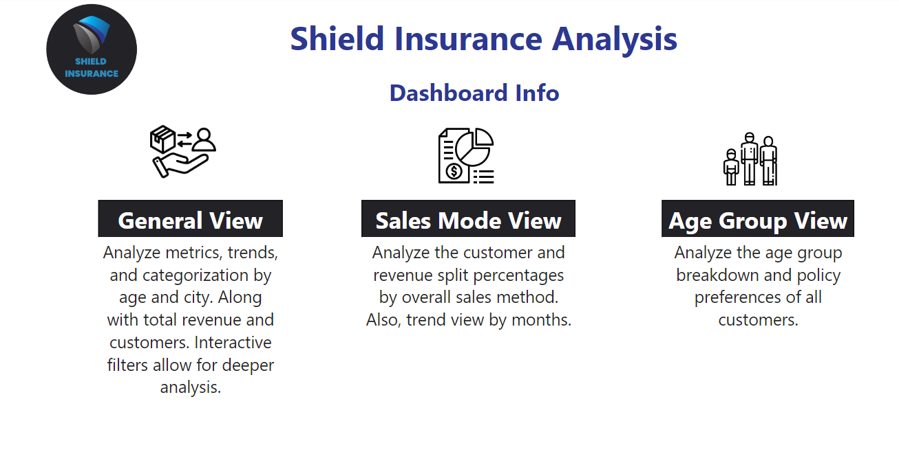
Home Page

Slide 4
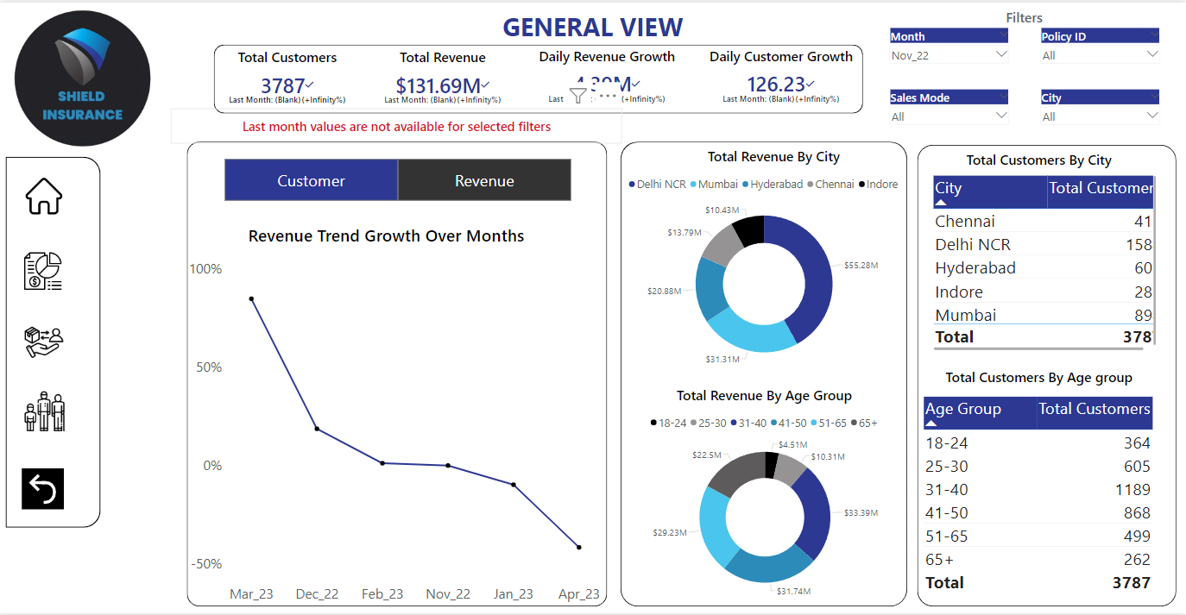
General View

Slide 5
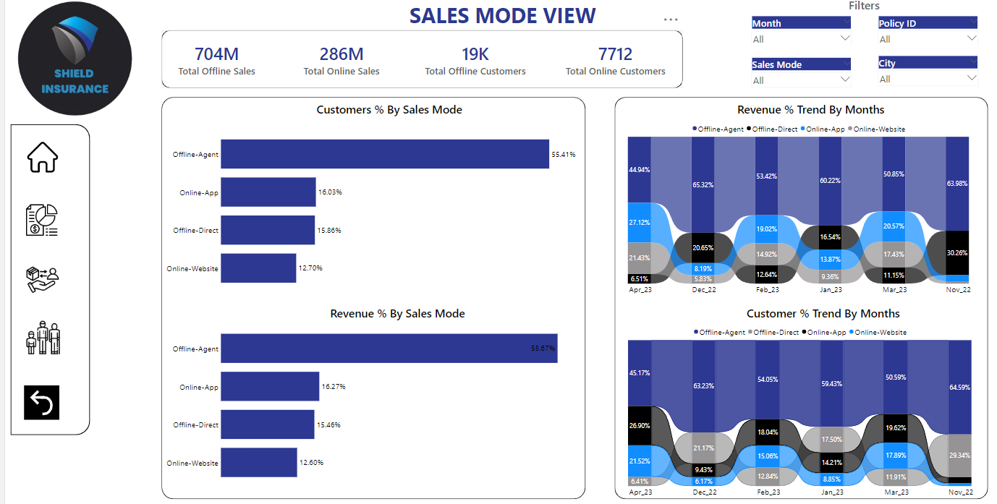
Sales Mode View

Slide 6
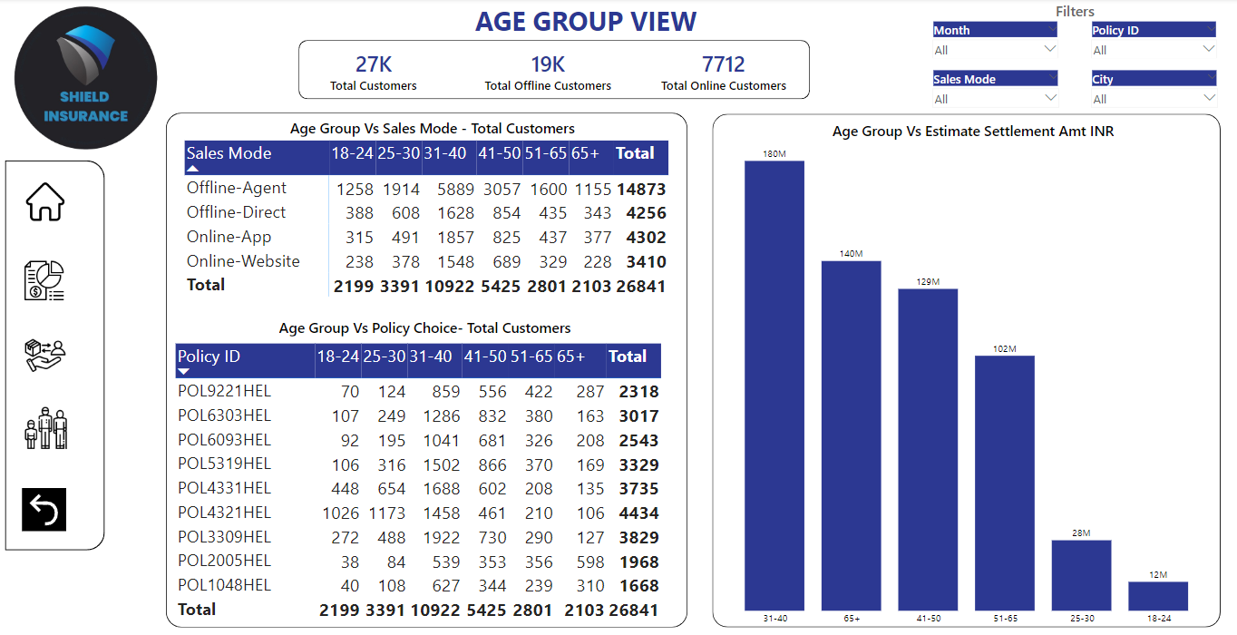
Age Group View

Slide 7

Key Finding
After going through the data and creating the Power BI report I analyzed and found that the most profitable month for the company is March 2023.
March is the most successful month in terms of generating revenue and also in acquiring customers.
The total revenue generated in March is 263.8M.
The total number of customers acquired in March is 7081.

Slide 8
The City with the highest number of customers and highest revenue is Delhi NCR.
The age group with the highest revenue and highest number of customers is 31-40 years.
The most successful sales mode for revenue and customer acquisition is the Offline-Agent mode.
The highest settlement expected is by the age group of 65 and above.
The top-selling Policy is POL4321HL with a Base Premium of Rs.5000.

Slide 9
Recommendation
Target age group : Focus marketing effort on the 25-30 age group to expand the customer base.
Digital Marketing: Increase online leads through digital marketing strategies, emphasizing online-website and inline-app promotion.
Senior Focused Policies: Introduce new policies tailored for the 65+ age group to attract and grow this demographics in the customer base.

